Slide 1
Enabling Decentralized Machine Learning on heterogeneous Microcontroller Networks.
Xiaoguang Guo
5/5/2024

Slide 2
Data redundancy
CPU-GPU Integrated
Architecture
Data redundancy elimination
ARM CPU
Model compression
MCUs
CPS
Hardware
Resources reallocation
Workload detection
Data
CPU-GPU co-run
Streaming-data
Data transmission
Cross devices
Distributed
On-device learning
Decentralized
Process directly without decompression
Compressed Data
Federated
Notes:
Distributed framework regular
MCUs how to communication
6iowpm bluetooth jig B limited
Target to which level MCUs
Wifi or

Slide 3
Background:
IoT ↑, MCUs
EdgeAI & AIoT: On-device learning, TinyML(Cloud -> MCUs)
Distributed learning: local learning -> FL -> swarm learning
Despite progress in decentralized and swarm learning, significant gaps persist at the microcontroller level.
Research Problem:
Can we design a data-driven, decentralized MCUs system utilizing swarm learning to solve real-world problems?
Contributions:
Swarm Learning Framework for Multi-Device Collaboration on MCUs.
Development of an Efficient Communication Protocol for Decentralized MCU Networks.

Slide 4
Smart Agriculture
Soil moisture, auto irrigation, pest activity, nutrient levels,…
Environmental Monitoring
Air & water quality, forest fires, illegal logging in remote areas
Health Monitoring
Emergency alert
Industrial IoT
Maintenance of machinery
Smart Cities
Traffic flow management
Wildlife tracking and conservation
Monitoring wildlife movements

Slide 5
Research questions:
How can swarm learning algorithms on MCUs be optimized for energy and computational efficiency in a decentralized network?
What communication protocols best support robust and efficient data exchange in intermittently connected decentralized MCU networks?
How can the network topology of decentralized MCU systems be dynamically managed to optimize learning and communication as nodes change?
What are the trade-offs between accuracy and efficiency in decentralized learning systems on MCUs?
How can machine learning models in decentralized MCU networks be dynamically adjusted in response to environmental changes?

Slide 6
System Architecture
MCUs Selection:
Sensor Integration:
Communication Infrastructure
Heterogeneous Communication System
Swarm Learning Algorithms
Algorithms Selection
Customization
Simulation

Slide 7
Communications Protocols:
Protocol | Description | MCUs Examples | Applications
Wi-Fi | TCP/IP, wide range | ESP8266, ESP32 | Smart home, IoT,
BLE | Short range, low power | nRF52840, ESP32 | Wearables
Zigbee | Mesh networking, | Xbee modules, CC2530 | Home automation
LoRa | Long range, rural areas | STM32(SX1278) | Agricultural sensors
CAN | Robust, noisy env, automative | ATmega32M1, STM32 | Automative networks
NFC | Very short range, secure | PN532 NFC, STM32 | Contactless payments

Slide 8
Begin with 3 MCUs.
Homogeneous (identical MCUs) or heterogeneous (different MCUs)?
One communication protocol or multiple protocols
Multiple tasks simultaneously or one single task distributed?

Slide 9
Communication Network Architecture
Peer-to-peer, Dynamic Mesh Topology
Nodes: ESP32
Protocols:
Wi-Fi Direct (no need Wi-Fi AP)
BLE?
Best path for data packets

Slide 10
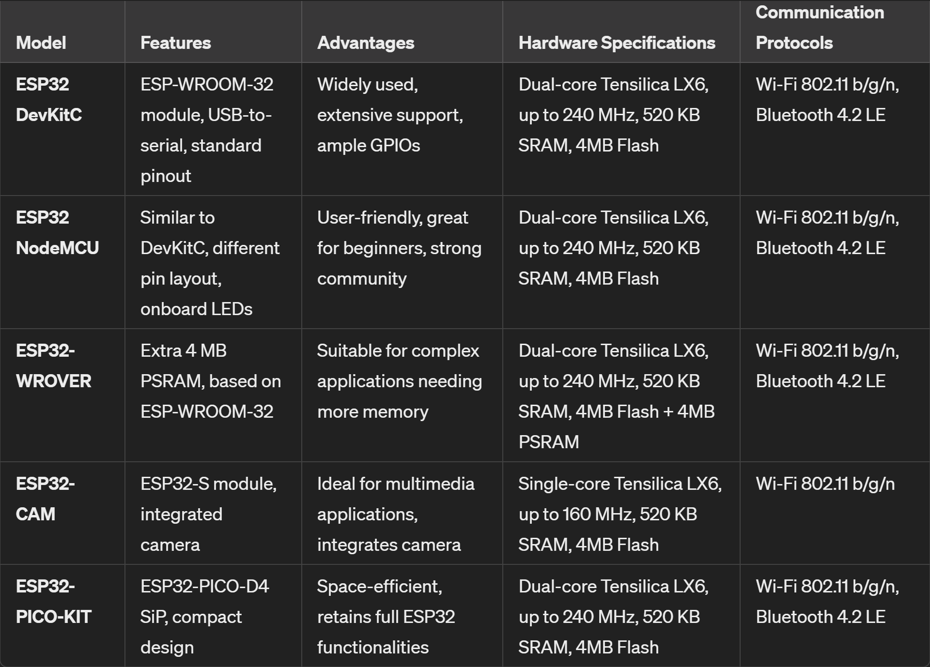
MCUs selection: ESP32-WROVER
https://www.amazon.com/gp/product/B0B3JD1K1T/ref=ox_sc_act_title_1?smid=A3S807LE0L63AP&psc=1 https://www.amazon.com/Freenove-ESP32-WROVER-Bluetooth-Compatible-Tutorials/dp/B0CJJHXD1W/ref=sr_1_2?crid=F1E4RMJ0368C&dib=eyJ2IjoiMSJ9.qRWqoY_UasjKo8Ke477M5cCkEpLxcPZqIAzXzRbPz-kVq5RbFAECDwEmGCtijln69j0TlvTjtibegiWc7lkIehlRMlnL7-UJEp_XkSgDB9whYNWhHsj-R9CdxqcuGV1IrYO6HDycrHPRSqW75PRFs_APxhMcHc7xtOMq_2E9I5bF_s-or5yihVbL9QRVQyKbtCmU5cJ4JLpJI5KJWO-52Nkx4k3YA15Gw2Tx2kA13G8.NP8mD56wBrTqJJQHvm9kXCRnOug7k8xrEhyc3TJV-pI&dib_tag=se&keywords=ESP32-WROVER&qid=1715748951&sprefix=esp32-wrover%2Caps%2C153&sr=8-2&th=1

Slide 11
Machine Learning Tasks:
Phase 1 (preloaded dataset)
Simulating real-world data distribution
Same Pre-built models on 3 devices
Existing frameworks: TensorFlow Lite, MicroML, …
Phase 2 (real-world application)
Sensors integration: Collecting data from each device

Slide 12
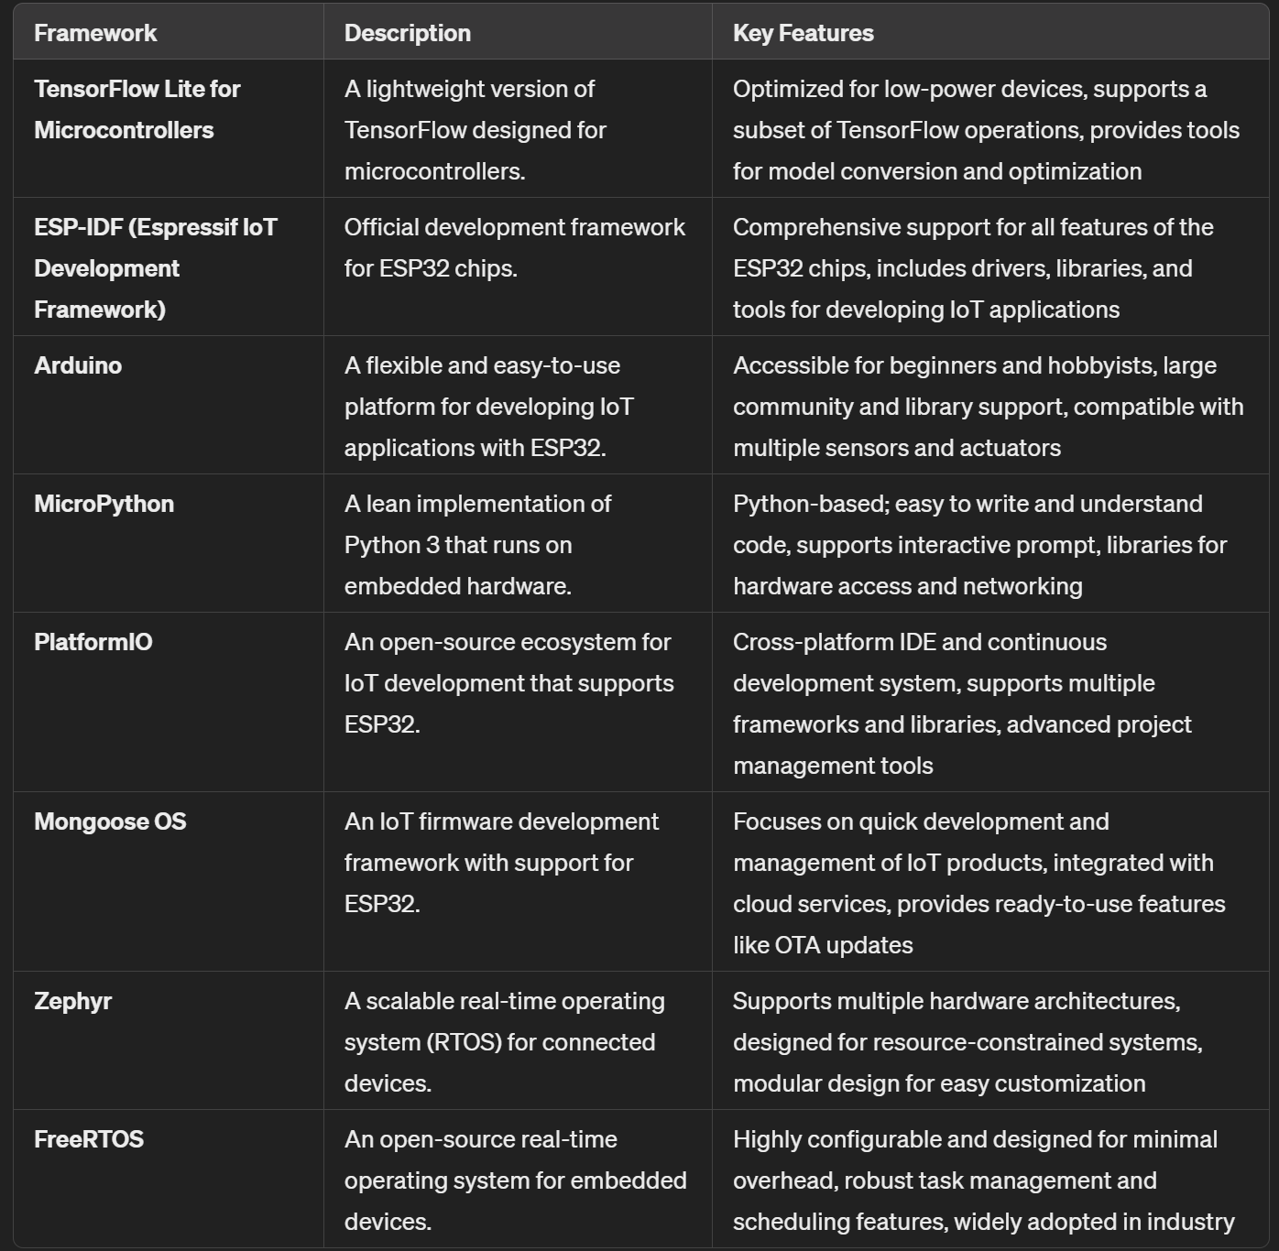
TinyML Frameworks:

Slide 13
A Systematic Literature Review on Distributed Machine Learning in Edge Computing
Table 8. EI frameworks
If applicable, decentralized learning frameworks
SWARM LEARNING: A SURVEY OF CONCEPTS, APPLICATIONS, AND TRENDS
Maybe MCUs network

Slide 14
System Objectives?
Hardware
AI accelerators?
Peripheral Integration: Sensors and actuators
Power
Decentralized Network Architecture
Topology Design: peer-to-peer?
Communication Protocol: Zigbee, bluetooth, LoRa
AI and Swarm Learning Components
AI Model Development: Pruning, Quantization, model compression,…
Local Learning
Model Sharing Mechanism
Blockchain protocol
Software Development
Firmware Development: data collection, local processing, and communication
Swarm Intelligence Algorithms: collaboration and adaptation

Slide 15
Notes before May 14th, 2024
We want to evaluate both BLE and Wi-Fi.
https://www.amazon.com/gp/product/B0B3JD1K1T/ref=ox_sc_act_title_1?smid=A3S807LE0L63AP&psc=1 https://www.amazon.com/Freenove-ESP32-WROVER-Bluetooth-Compatible-Tutorials/dp/B0CJJHXD1W/ref=sr_1_2?crid=F1E4RMJ0368C&dib=eyJ2IjoiMSJ9.qRWqoY_UasjKo8Ke477M5cCkEpLxcPZqIAzXzRbPz-kVq5RbFAECDwEmGCtijln69j0TlvTjtibegiWc7lkIehlRMlnL7-UJEp_XkSgDB9whYNWhHsj-R9CdxqcuGV1IrYO6HDycrHPRSqW75PRFs_APxhMcHc7xtOMq_2E9I5bF_s-or5yihVbL9QRVQyKbtCmU5cJ4JLpJI5KJWO-52Nkx4k3YA15Gw2Tx2kA13G8.NP8mD56wBrTqJJQHvm9kXCRnOug7k8xrEhyc3TJV-pI&dib_tag=se&keywords=ESP32-WROVER&qid=1715748951&sprefix=esp32-wrover%2Caps%2C153&sr=8-2&th=1

Slide 16
Swarm learning is an overlay network.
Block chain is necessary for all current system setup.
For micro controller local network, is block chain feasible?
What kind of block chain platform or market is assumed or built on?
Distributed or decentralized on micro-controller ML learning.
Multiple local devices (who distributes IPs)
No centroid node.
Wi-Fi or Bluetooth?

Slide 17
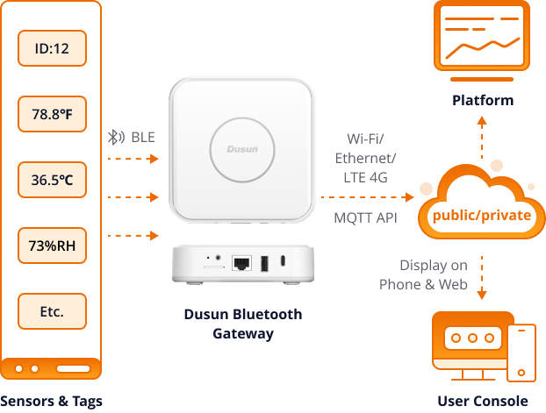
https://www.dusuniot.com/blog/bluetooth-iot-deploying-your-iot-projects-with-ease-and-low-cost/

Slide 18
Feature | Bluetooth Classic | Bluetooth Low Energy (BLE)
Frequency Range | 2.402GHz to 2.48GHz | 2.402GHz to 2.48GHz
Range | Up to 100 meters | Up to 100 meters
Data Transfer Rate | 1-3 Mbps | 125 Kbps – 2 Mbps
Communication Mode | Continuous | Short bursts
Power Consumption | Higher | Lower
Voice & Large File Transfer | Yes | No
Latency | Up to 100ms | 6ms
Power Usage | 1 Watt | 0.01 to 0.5 Watts
Bidirectional Communication | Yes | Yes
Unidirectional Communication | No | Yes
Indoor Location Tracking | Limited accuracy | Yes
Asset Management | Limited tracking capabilities | Yes
PC Peripherals Support | Yes | Limited support
Security | AES-128 encryption | AES-128 encryption

Slide 19
Is block chain feasible?
Lightweight Blockchain Protocols:
Tangle (IOTA): Utilizes a directed acyclic graph reducing resource consumption.
Nano’s Block-Lattice
Consensus Mechanism:
Proof of Authority (PoA): Selected nodes (authorities) validate transactions, reducing computational load.
Delegated Proof of Stake (DPoS): Stakeholders vote for a small number of delegates to validate transactions.
Practical Byzantine Fault Tolerance (PBFT): Optimized for low-latency networks with known participants
Hybrid Blockchain IoT networks

Slide 20
Step | Component(s) Involved | Description | Hardware Specifications
Node Initialization | ESP32-WROVER, Blockchain Client | Initialize the ESP32-WROVER nodes and set up blockchain clients. | Dual-core Xtensa LX6, 240 MHz, 8MB PSRAM, 4MB Flash
Data Collection | ESP32-WROVER, Sensors | Collect sensor data (e.g., temperature, humidity, air quality) from the environment. | Various sensors connected via GPIO, I2C, SPI, UART
Data Preprocessing | ESP32-WROVER | Preprocess collected data (e.g., noise reduction, normalization) before training. | Dual-core Xtensa LX6, 240 MHz
Local Model Training | ESP32-WROVER, TinyML Frameworks | Train local ML models using the preprocessed data. | TensorFlow Lite for Microcontrollers, uTensor, 8MB PSRAM
Model Update Creation | ESP32-WROVER, Blockchain Client | Create a blockchain transaction containing the local model update (parameters). | Integrated blockchain client, 4MB Flash
Transaction Signing | ESP32-WROVER, Crypto Engine | Sign the transaction using the node’s private key to ensure authenticity. | AES, SHA-2, RSA, ECC
Transaction Broadcasting | ESP32-WROVER, Communication Module | Broadcast the signed transaction to other nodes in the network. | Wi-Fi 802.11 b/g/n, Bluetooth 4.2
Consensus Mechanism | ESP32-WROVER, Blockchain Network | Validator nodes verify transactions and add them to the blockchain. | Integrated blockchain client, PoA or DPoS consensus
Model Aggregation | ESP32-WROVER, Smart Contracts | Smart contracts aggregate model updates from different nodes into a global model. | Integrated blockchain client, Smart Contracts
Global Model Deployment | ESP32-WROVER, TinyML Frameworks | Deploy the aggregated global model to all nodes for inference. | TensorFlow Lite for Microcontrollers, uTensor
Inference and Action | ESP32-WROVER, Sensors, Actuators | Use the global model for real-time predictions and trigger actions based on predictions. | Dual-core Xtensa LX6, 240 MHz, various sensors and actuators
Data Persistence and Storage | ESP32-WROVER, Flash Memory | Store critical data, model parameters, and blockchain ledger in Flash memory to ensure data persistence. | 4MB Flash Memory

Slide 21
Component | Specifications | Role
ESP32-WROVER Node | Dual-core Xtensa LX6, 240 MHz 8MB PSRAM 4MB Flash Wi-Fi 802.11 b/g/n, Bluetooth 4.2 | Main node for data collection, preprocessing, local model training, and blockchain operations.
Sensors | Connected via GPIO, I2C, SPI, UART | Collect environmental data (e.g., temperature, humidity, air quality).
Data Collection | Using sensor interfaces | Collect data from sensors for processing.
Data Preprocessing | Dual-core Xtensa LX6 | Clean and normalize collected data for model training.
Local Model Training | TensorFlow Lite for Microcontrollers, uTensor, … | Train ML models using preprocessed data.
Inference | Using trained ML models | Make predictions based on new sensor data.
Storage (Flash) | 4MB Flash Memory | Store critical data, model parameters, and blockchain ledger.

Slide 22
Component | Specifications | Role
Blockchain Client | Software running on ESP32-WROVER | Manages blockchain transactions, consensus participation, and smart contract execution.
Transaction Creation | Using local data and model updates | Create blockchain transactions with collected data or model parameters.
Transaction Signing | AES, SHA-2, RSA, ECC | Sign transactions using cryptographic keys to ensure authenticity.
Consensus Participation | PoA or DPoS consensus | Participate in the consensus process to validate transactions and add blocks to the blockchain.
Model Aggregation | Using smart contracts | Aggregate model updates from different nodes into a global model.
Smart Contracts | Executed on the blockchain | Automate actions based on blockchain data (e.g., reward distribution).
Global Model Deployment | Deploying aggregated model | Deploy the global model to all nodes for inference.
Data Persistence | Storing in Flash memory | Ensure critical data is securely stored and remains persistent across power cycles.

Slide 23
Part | Components | Action
Model Update Creation | ESP32-WROVER, TensorFlow Lite for Microcontrollers | - Train the local model on preprocessed data. - Extract model parameters (e.g., weights). - Create a transaction: `{ "node_id": "Node1", "model_update": { "weights": [0.1, 0.5, ...], "biases": [0.3, 0.7, ...] }, "timestamp": "2024-05-15T12:00:00Z" }`
Model Sharing | ESP32-WROVER, Blockchain Client | - Sign the model update transaction using the node’s private key. - Broadcast the signed transaction to other nodes in the network using Wi-Fi or BLE.
Model Aggregation | Smart Contracts, Blockchain Network | - Collect model updates from various nodes. - Execute smart contracts to aggregate model updates: - Aggregation formula: `Global Weight = (1/N) Σ Node Weight_i` - Store aggregated model parameters on the blockchain.
Global Model Deployment | ESP32-WROVER, Blockchain Client | - Monitor the blockchain for new global model updates. - Retrieve the aggregated global model parameters. - Update the local model with the new global parameters: `updateModel(globalParams)`

Slide 24
R

Slide 25
Research Goals:
Minimizes Energy Consumption
Maximizes Performance
Handles Randomness and Uncertainty
Challenges:
Data Distribution
Decentralized Coordination
Energy Efficiency
Dynamic Synchronization
Subset Selection for Training
Communication Protocols

Slide 26
Research Questions
How to design energy-efficient swarm learning algorithms for MCUs?
What are the optimal communication protocols and synchronization strategies for decentralized MCU networks?
How to dynamically manage the network topology and MCU participation to optimize learning efficiency and energy consumption?
What are the trade-offs between training on subsets of MCUs versus the entire network?

Slide 27
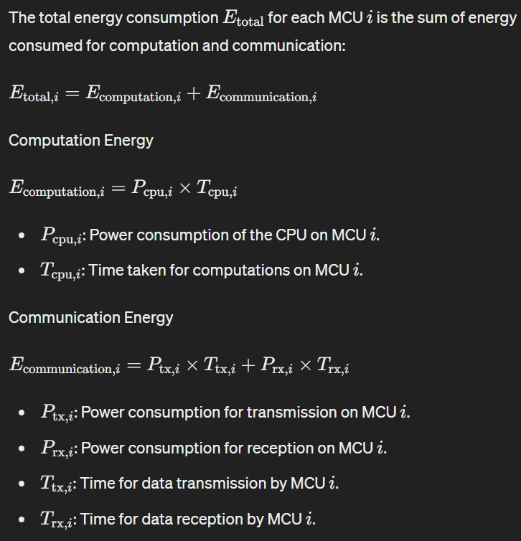
Theoretical Framework
Energy Consumption Model

Slide 28
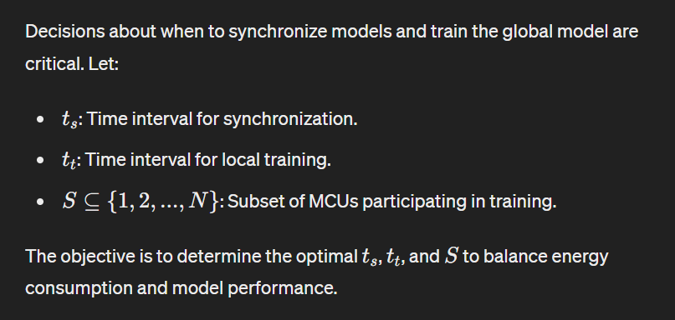
Synchronization and Training Strategy

Slide 29
Objective Function:
Minimize the total energy consumption while maximizing model performance.
Constraints:
Ensure communication delays L are minimized.
Meet a minimum accuracy threshold A_min
Adapt to dynamic availability and participation of MCUs.

Slide 30
Data Distribution
Data bias
Do we need to redistribute data?

Slide 31
Global model

Slide 32
R
https://www.youtube.com/watch?v=e7o2C0lPrKg
Model parallel

Slide 33
Dist

Slide 34
Distributed communication:
All-Reduce Ring

Slide 35
Dist

Slide 36
BLE

Slide 37
BLE
Bluetooth Mesh Networking
Managed flooding
Direct forwarding

Slide 38
BLE
Provisioning: the process of adding a device to a BLE Mesh Network
Proxy Node: a node that acts as an interface between a BLE Mesh Network and non-mesh BLE devices.
Friend Node: a node that stores messages for low-power nodes.
Low Power Node(LPN): a node that saves power by frequently sleeping and relies on a friend node.
Element: a functional unit within a node that can send and receive messages
Publish/Subscribe: mechanism for nodes to send and receive messages

Slide 39
BLE Stack
Controller: this is the hardware part of the Bluetooth system, usually an integrated circuit or module that handles the radio frequency communication and basic operations
Host: this is the software part of the Bluetooth system running on the main processor. It implements higher-level protocols and profiles.
Host Controller Interface (HCI): this standard protocol allows communication between the Host and the Controller. It defines commands, events, and data packets.

Slide 40
Over-the-Air(OTA) updates
Prepare the Firmware Image
Setup the Initial Provisioner Node
Firmware Transfer Protocol: BLE Mesh
OTA Handlers

Slide 41
BLE
Master Node Setup (Provisioner and OTA Server)
Initialize BLE Mesh and Provisioning
Implement Automatic Provisioning
Implement OTA Update Functionality

Slide 42
BLE
Pre-configure each node

Slide 43
BLE

Slide 44
BLE

Slide 45
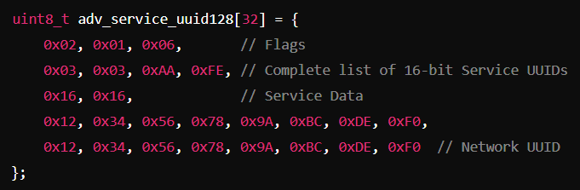
BLE Advertising Info
Advertising Packet

